Slide 1
Welcome to Torino!

Slide 2
Università degli studi di Torino Corso di Laurea in Medicina e Chirurgia Polo di Torino

Slide 3
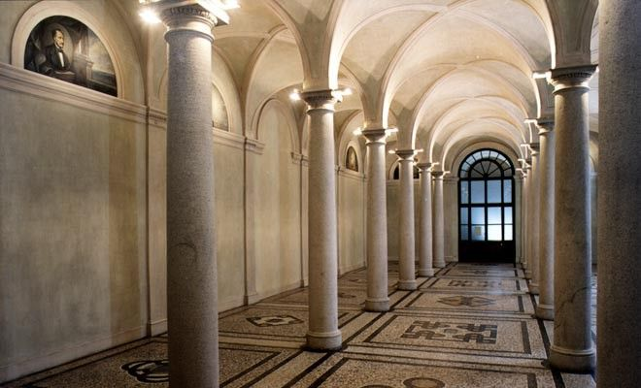
Our Faculty has not a central and unique location: classrooms are located in different buildings in the area near “Città della Salute e della Scienza”.
The classroom is usually the same throughout the semester but it is different for each year .

Slide 4
This is the area where classrooms are located. It is divided into: - POLO BIOLOGICO - POLO CLINICO

Slide 5
Azienda Ospedaliera Universitaria Città della Salute e della Scienza di Torino
It is the University’s central Hospital, the largest hospital of Piemonte and the third in Italy. It is also known as Molinette.
In fact it is a set of hospital facilities, connected by underground corridors.
Corso Bramante, 88/90 - 10126 Torino (Tel. 011-633.1633).

Slide 6
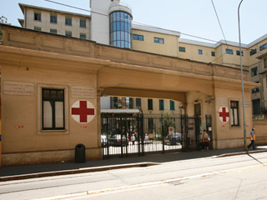
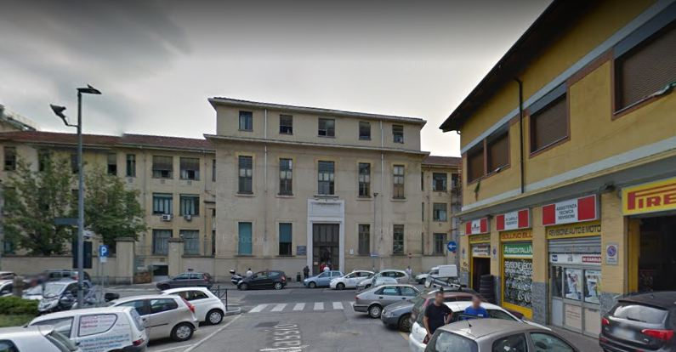
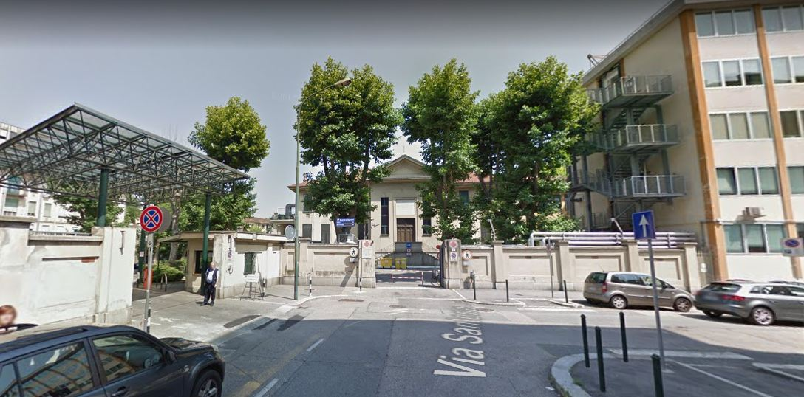
C.So Bramante 88/90
Via Genova 3
Via Cherasco 15
Via Santena 5
Because of its big dimension, there are many different entrances.

Slide 7
UniTo Students Secretaries
ERASMUS OFFICE CONTACT INFORMATION:
Tel.: +39.011.6704425 (casella vocale) Fax: +39.011.2361017 Email: internationalexchange@unito.it
Remember: You must ask for an appointment by email or call the office!
All the procedures for incomings are available at :
www.unito.it → Internazionalità → Studenti e Ospiti Internazionali → Studenti Erasmus e in mobilità.
Or : international relations → student’s mobility → Erasmus and exchange students
INFOPOINT OFFICE:
Adress: Via Po, 29 Torino Tel.: +39.011.6703020/3021 (casella vocale) Fax +39.011.6703012 E-mail: infopoint@unito.it . Opening hours: Monday and Friday from 09:00 to 16:30; Tuesday, Wednesday and Thursday from 09:00 to 19:00.
Remember to register ASAP your arrival (and your departure at the end of your Erasmus stay) at the INFOPOINT. Those dates will be the official ones of your enrollment at our University

Slide 8
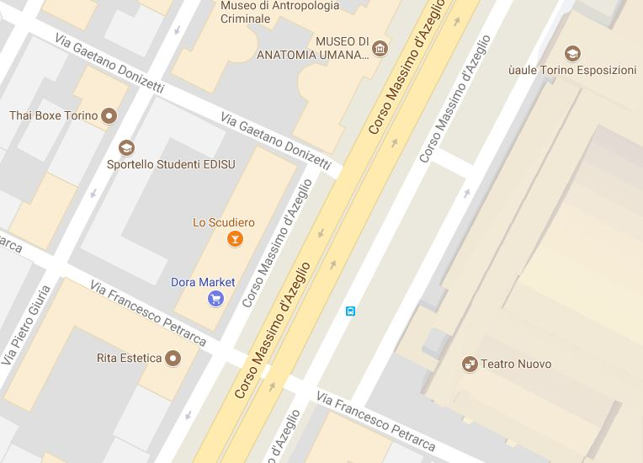
School of Medicine secretariat
SEGRETERIA STUDENTI – SCUOLA DI MEDICINA:
Corso Massimo d'Azeglio 60,
Opening hours: Monday and Friday 09.00-11.00 , Tuesday, Wednesday and Thursday 09.00-11.00 e 13.30-15.00.
Tel: +39 011 670 5695/6/7/8/9 Fax: +39 011 670 5678 e-mail: segrstu.chirurgia@unito.it
DIREZIONE DIDATTICA E SERVIZI AGLI STUDENTI DELL'AREA DEL POLO MEDICINA TORINO:
Corso Dogliotti 38, above the Odonto study room.
Opening hours: Monday and Thursday h. 13.00 to h. 15.00.
Tel. 011 670 5498 Fax 011 236 1088.
Email: servizistudenti.dam@unito.it .
Why should you go there? When you need to solve a problem concerning your apprenticeship, or to ask for tutor’s help.

Slide 9
Erasmus Referents
L. Charrier (lorena.charrier@unito.it) and F. Cavallo (franco.cavallo@unito.it) are the referent professors during your Erasmus stage. They can help you with teaching problems (learning agreement, practical trainings,…).
Contact them to get an appointment ASAP at your arrival in Torino
Please, contact the Erasmus Office (internationalexchange@unito.it) if you have administrative problems concerning your application, deadlines related to your mobility, exams application, online career compilation, problems with your login or password to enter MyUnito.

Slide 10
The academic year
It is split into two semesters:
1. from October to January.
2. from March to June.
From the 4th year of studies, the semester is composed of alternating blocks of 3 weeks: 3 for lessons and 3 for practice.
Remember that Erasmus incoming students have to refer to Italian Erasmus referents for arranging their practical activities!
This are the important dates for the academic year 2017/2018:
FIRST SEMESTER: From 02/10/2017 to 02/02/2018.
academic break : 01/11/2017; 08/12/2017; from 23/12/2017 to 05/01/2018
SECOND SEMESTER: From 05/03/2018 to 08/06/2018
academic break : from 29/03/2018 to 03/04/2018; 25/04/2018; 30/04/2018-01/05/2018
Remember: Attendance to courses is compulsory! If you are not in the students’ list, please add your name at the end of the list and sign it, as a proof of your lessons attendance! Discuss with your professors at the beginning of the semester, if you have problems for attending all lessons, because of overlaps in your schedule.

Slide 11
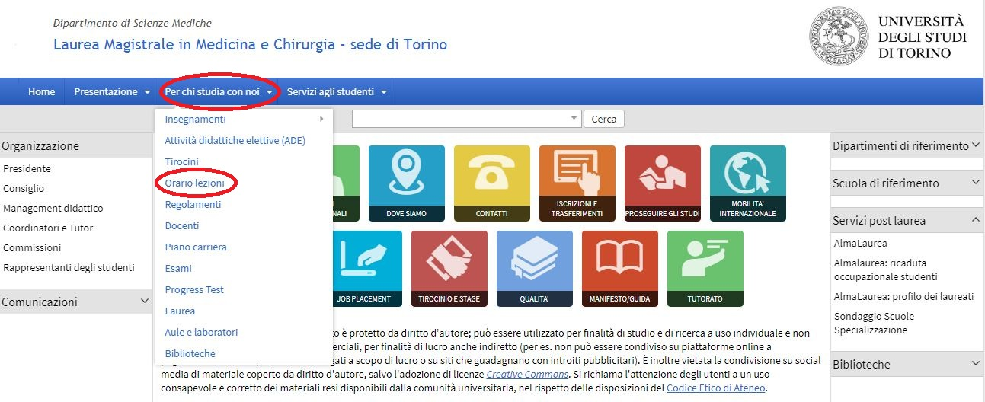
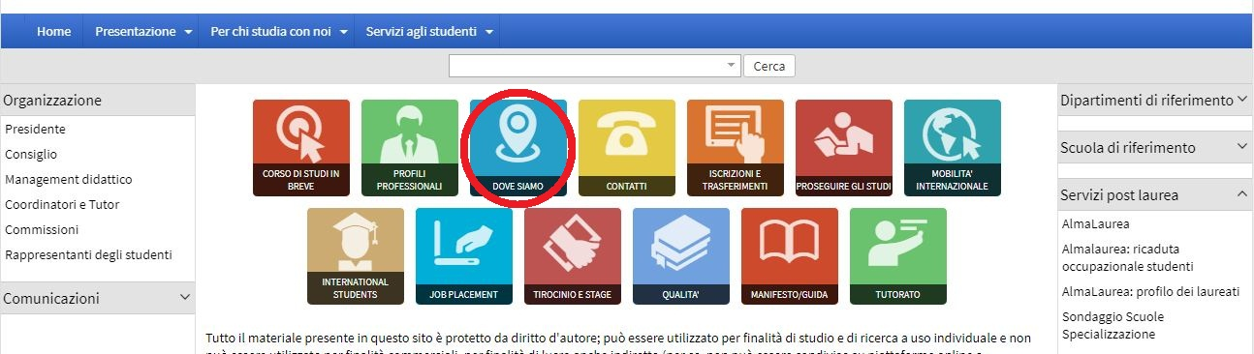
How can you get information about the location of your classroom?
http://medchirurgia.campusnet.unito.it/do/home.pl
To see the timetable:
“Per chi studia con noi” → “orario lezioni”.
Then you can choose the year of study and the «Canale» (group).
There are two «canali»: A and B, on the basis of the first letter of a student’s surname (A to K = canale A; L to Z = canale B).
To see where the classrooms are: →”Dove siamo”

Slide 12
Exams
There are 3 ordinary periods of exams (winter, summer and autumn sessions) and 2 extraordinary ones (Christmas and Easter sessions). Christmas session is available only for courses attended in the previous academic year – 2016-17!!, not allowed for courses attended from September to December 2017.
For each session there may be one or more exams dates (usually 2 in the ordinary and 1 in the extraordinary sessions, so there are 8 dates for each exam along the year).
EXAMS PERIODS:
Winter session: from 05/02/2018 to 02/03/2018
Easter session: 4-5-6 April 2018 (for courses attended during I semester only)
Summer session: from 11/06/2018 to 31/07/2018
Autumn session: from 03/09/2018 to 28/09/2018
«Appello» is the word used to indicate the exam’s calling date.

Slide 13
To sign for an exam/ADE/training:
You must enter your personal site “MyUnito” (www.unito.it →login).
In the top menu select «esami» (or “exams” in the English version).
In “Appelli disponibili” (Available exams sessions) there is the list of available exam dates. To enroll for the activities or the exam you are interested in you must select the icon of the book on the left.
“Bacheca prenotazioni” (Exams booking board): shows the exams or activities you have reserved.
Remember: you can only enroll for an exam in a selected period, so check carefully the beginning and finishing date of this period.
In “Bacheca esiti” (Results notice board) there are the results of your exams. To accept or reject your mark you may click on the icon near the result. If you don’t answer in 5 days, the mark is considered accepted and won’t be possible to change it.

Slide 14
Remember!
→ Without the online registration, the professor will not be able to register your exams, so they will not appear in the final Transcript of Records (TOR)
→ Online registration is allowed exclusively for exams/ADE/TIROCINI included in the student’s Career Plan. Don’t forget to complete it online!
→ In any case of problems related to the exam registration process, please contact internationalexchange@unito.it
→ For the final evaluation of your practice, in order to get it in the final TOR, please complete the online registration (in the same way as you have done to enroll for an exam date)
→ On Campusnet you will find the “certificates of attendance” of your practice. Please, download this file, fill them in, one for each practical training, and make them signed by your clinical tutors
→ Before starting your practice period, you are supposed to attend a Medical visit at the Occupational Medicine Department (bring your vaccinations certificate with you) and complete a written, multiple choice test about the risk in Medical structures. Don’t worry, the Italian Erasmus referents will help you to manage all this procedure.

Slide 15
Very important websites to check during your erasmus stage!
campusnet →
http://medchirurgia.campusnet.unito.it/do/home.pl
Some information you can find in the website:
News and notifications.
Lessons timetable.
Professors contacts, information about the courses, teaching materials posted by the professor himself, lessons planning and type of exam: «per chi studia con noi» → “insegnamenti”
Classroom and laboratories location: «per chi studia con noi» → “aule laboratory"
Information about the clinical tutoring or the tutoring offered by other students: in the home page you have to click «tutorato».
If you don’t find the answer to your request you can write an email to servizistudenti.dam@unito.it

Slide 16
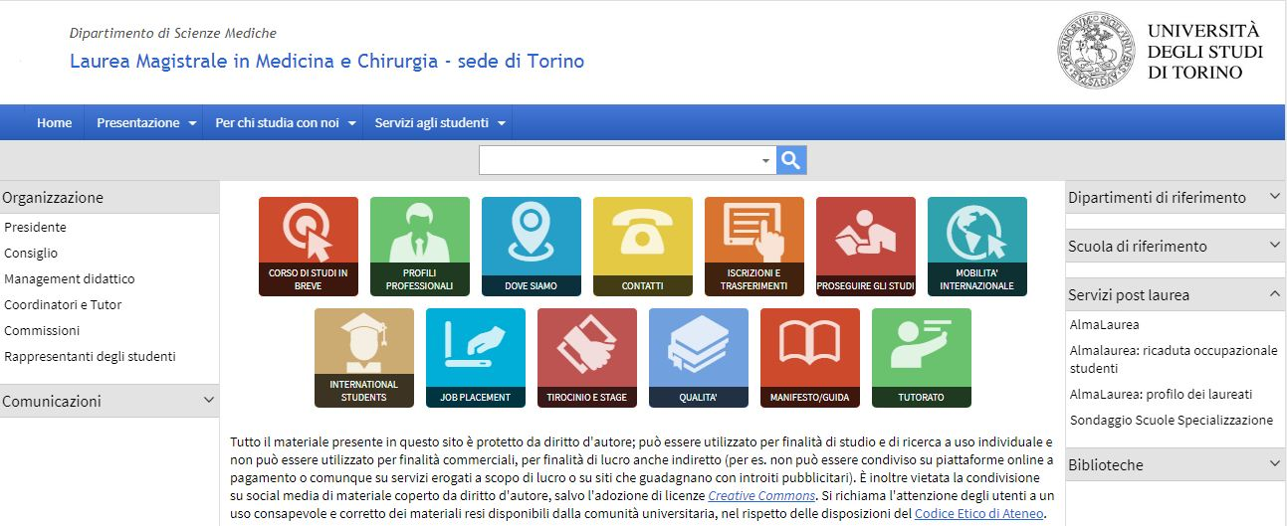
Campusnet site contains some important information about your Erasmus stage.
In this page you can click on «Mobilità internazionale» to find the Study plan 2017-2018, a useful document about “to do things” at your arrival and the certification of professional training activities.

Slide 17
UNITO – ESSE 3
In the right menu «chi sei?» you must select “studente” and there you can find all the services offered by UniTo to its students.
If you need the online services dedicated to the Erasmus mobility you must select «internazionalità» on the top →”studenti e ospiti internazionali” → “studenti erasmus e in mobilità” or international relations → student’s mobility → Erasmus and exchange students.
There you can see all the links to fulfill the mobility burocracy.
Esse3 is MyUniTo’s network. Login is at the top of the home screen, on your right.
There you can enroll to any exam, see the exams’ results or the reservations you made, and access your university mail.

Slide 18
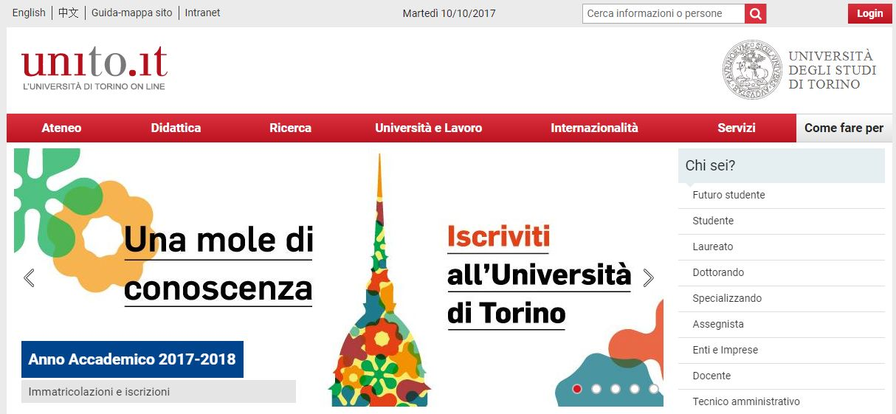
Unito.it has an English version. To see it, select “English”, at the top of the page, on the left.

Slide 19
Study rooms and libraries
L’Opera (via Michelangelo 17). It is the biggest and newest study room in the area.
Opening hours: Monday - Friday 8.30-24.00 , Saturday – Sunday and Holiday 8.30-22.00. during exams period it closes at 2.00 a.m. everyday.
Biblioteca del polo biologico (Corso Raffaello 30), it is at the same time a study room and a library where you can read textbooks and scientific papers.
Opening hours: Monday – Friday 9.00-17.00
Bunker (via Giuria) Opening hours: Monday – Friday 8.30-19.00
Aula studio ex Palazzina di Odontoiatria (Molinette) a new study room with a room for lunch time or to study in groups, with fridge and microwave. It is reserved for medicine students. Opening hours: Monday – Friday 8.30 -20.00.

Slide 20
Other study rooms
You can find a description of the available rooms at the UniTo website: http://medchirurgia.campusnet.unito.it/do/home.pl/View?doc=dove_siamo.html
To search for others study rooms provided by Edisu you can follow this link: http://www.edisu.piemonte.it/Macroaree/Sale-studio-e-altri-servizi/Sale-studio/Servizi-e-sedi
Others libraries
The list of UniTo libraries is available at the following link:
https://www.unito.it/ateneo/strutture-e-sedi/strutture/biblioteche
For medicine libraries we suggest to use the web page of BFM (Biblioteca Federata di Medicina “Ferdinando Rossi”): https://www.bfm.unito.it/it .
Medicine libraries offer services of free book consultations and loan; you can ask for information to the staff.

Slide 21
UNIVERSITY MAIL
To access to your mail you can use MyUniTo page: Webmail degli studenti
The online procedure of exams reservation and marks confirmation sends you automatic mails to the university account (username@edu.unito.it) so you must remember to check constantly your university account!

Slide 22
Health care
EDISU Piemonte has a specific Office offering information and clarification about the access to the “Servizio Sanitario Nazionale - SSN ” (National Health Service) for people studying in Turin (EU and non-EU students).
At the Information point and in all EDISU University dormitories, you can find a specific form to choose a SSN’s doctor available.
To get an appointments you must contact the Ufficio Assistenza Sanitaria EDISU PIEMONTE:
Address: Via Sant’Ottavio 10/b 10124 - Torino
tel. 331 6109713
e-mail: ezio.chionio@edisu-piemonte.it

Slide 23
OTHER SERVICES
UNIVERSITY WIFI
After the login with the UniTo username and password, you may use free WiFi of our university!
WiFi zones are marked by the official symbol.

Slide 24
LOOKING FOR SOMEWHERE TO LIVE
The University of Torino provides a range of options to help its international students and guests to find an accommodation in the city. It is possible to look for an accommodation through the services:
• Sportello Casa Service (private flats or shared apartments with other students): the University of Turin offers Erasmus students free assistance in finding apartments and rooms in the city.
Via Verdi 26/a - 10124 Torino
Tel. 011.8138328
Fax. 011.8391463
http://www.sportellocasapiemonte.it/en-us/home-page.aspx?idC=61642&LN=en-US
e-mail: torino@sportellocasapiemonte.it
Internet platform Housing Anywhere: it is a student-to-student housing platform for exchange and internship students. Housing Anywhere is a very effective tool which increases the housing offers and the amount of short term accommodation for incoming exchange students.
• Edisu University Residences (temporary accommodation ONLY for Erasmus students).
Once arrived in Torino, you will also find several offers on the notice boards for students in the Schools/Departments buildings.

Slide 25
CUS - Torino
CUS Torino is the university sports center. It organizes a lot of sport activities and competitions with special offers for students.
With the CUS card you can access the sport facilities, activities and discounts; it allows you to rent a tennis, beach volley or football court.
To see the list of the discounts and the activities you may also use the page www.custorino.it , send an email to erasmus@custorino.it or call +39.011.338307.

Slide 26
Enjoy your Erasmus in Torino!

